Slide 2
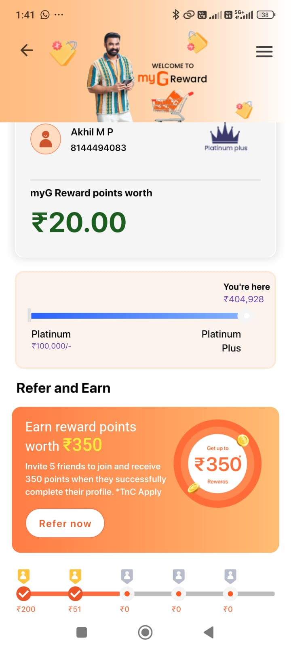
Loyalty Engagement App
Usage trend, promotion plan, and platform features
Unique Customers by Month
App Features
Loyalty To Next Level
Profile update, loyalty points & slab
Purchase history & download
Refer & earn
Complaint registration
Games (pending)
Gdot & myG Care service status (pending)
Promotion campaign ideas
1
Social Media Presence
Facebook, Instagram, YouTube, etc.
2
Print & TV Advertising
Newspaper space & TV ad spots
Loyalty Engagement App
3
QR Code Campaign
Central hub for members to track and redeem loyalty benefits.
In-store & print QR touchpoints
88,820 unique customers total · *Jul partial (thru 21st)

